Slide 1
Communication and internet Services
GST 112

Slide 2
COMMUNICATION
What is Computer Communication?
Computer communication describes a process in which two or more computers or devices transfer data, instructions, and information from one point to another point.
Some communications involve cables and wires; others are sent wirelessly through the air. Communication systems contain all types of computers and computing devices.

Slide 3
Devices required for successful communication
Sending device: It initiates an instruction to transmit data, instructions, or information
Receiving device: it accepts the transmission of data, instructions, or information.
Communication channel or transmission media : is a channel on which the data, instructions or information travel. Examples are cable television line and telephone lines.
Communication devices: it connects the sending device or receiving device to a communications channel. One example is MODEM

Slide 4
Devices required for successful communication
All types of computers and mobile devices serve as sending and receiving devices in a communications system. This includes mainframe computers, servers, desktop computers, notebook computers, smart phones, portable media players, and GPS receivers

Slide 5
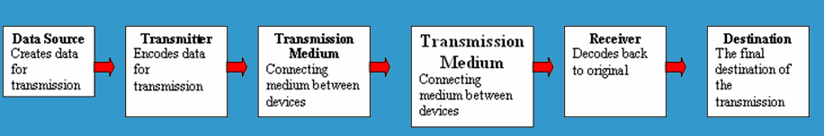
Basic Components
Every communication system has 5 basic requirements
Data Source (where the data originates)
Transmitter (device used to transmit data)
Transmission Medium (cables or non cable)
Receiver (device used to receive data)
Destination (where the data will be placed)

Slide 6
Transmission Media Speed
Bandwidth:The amount of data which can be transmitted on a medium over a fixed amount of time (second). It is measured on Bits per Second or Baud
Bits per Second (bps): A measure of transmission speed. The number of bits (0 0r 1) which can be transmitted in a second
Baud Rate: Is a measure of how fast a change of state occurs (i.e. a change from 0 to 1)

Slide 7
Protocols
Protocol is a standard that specifies the format of data as well as the rules to be followed during transmission. It is a procedures, rules, or standards that must be followed by computers when sending or receiving data. Protocols allow communication between computers and networks. Protocols will determine the speed of transmission, error checking method, size of bytes, and whether synchronous or asynchronous.
There are three commonly used protocols; they are
Ethernet (Ethernet Network)
Carrier Sense Multiple Access/Collision Detection (CSMA/CD)
TCP/IP

Slide 8
Ethernet
Developed at Xerox in 1976.
First protocol approved as an industry standard protocol 1983
LAN protocol used on bus and star topology
Most popular LAN protocol
Inexpensive

Slide 9
Carrier Sense Multiple Access/Collision Detection (CSMA/CD)
Used on bus networks to avoid data collisions.
It is a set of rules that determine how network devices responds when two devices attempt to use a data channel simultaneously.

Slide 10
TCP/IP
Developed in 1973 for use on the ARPANET which was a defense force research network.
Adopted in 1983 as the Internet standard. all hosts on the Internet are required to use TCP/IP.
- Allows transfer of data using packet switching

Slide 11
Communication Concepts
Any transmission May be:
Analog /Digital
Serial /Parallel
Synchronous / Asynchronous

Slide 12
Analog and digital transmission
In analog transmission, data are sent as a continuous electrical signal in the form of wave.
Digital transmission sends data as distinct pulses either on or off, in much the same way that data travels through the computer.

Slide 13
Serial Transmission
Data is transmitted, on a single channel, one bit at a time one after another
- Much faster than parallel because of way bits processed (e.g. USB and SATA drives)
Sender transmitted
Receiver received
1
0
0
1
1
0
0
1

Slide 14
Parallel Transmission
In parallel transmission, each bit has it’s own piece of wire along which it travels
It is often used to send data to a printer
1
0
0
1
Receiver received
Sender transmitted
1
0
0
1
All bits are sent simultaneously

Slide 15
Why Not use Parallel Instead of serial?
Due to inconsistencies on channels data arrives at different times
Because of the way it is transmitted packet switching cannot be used
The above two points makes parallel slower than serial and requires higher bandwidth.
Parallel transmissions are rarely used anymore

Slide 16
Synchronous Vs Asynchronous Transmissions
Synchronous Transmission
In synchronous communication, all data sent at once and no packet switching
Asynchronous Transmission
Uses stop/ start bits
most common type of serial data transfer
Allows packet switching
Allows sharing of bandwidth (i.e. talk on phone while another person is using internet)

Slide 17
Transmission mode
There are three ways, modes for transmitting data from one point to another. These are
Simplex mode:- If transmission is simplex, communication can take place in one direction. For example TV, radio
Half-duplex mode:- A half-duplex system can transmit data in both directions but only in one direction at a time. For example wireless.
Full-duplex mode:- A full-duplex system allow information to flow simultaneously in both direction on the transmission path. For example telephone

Slide 18
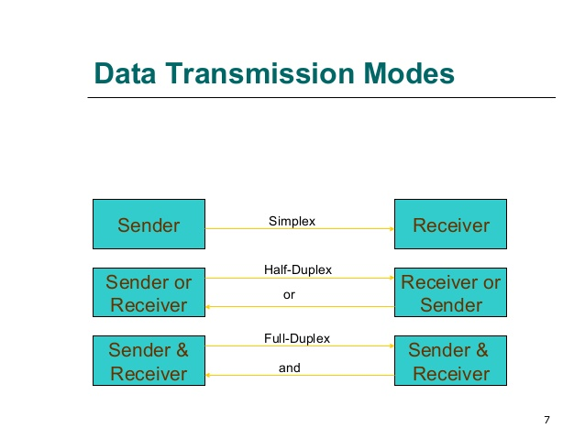
Simplex mode:- If transmission is simplex, communication can take place in one direction. For example TV, radio
Half-duplex mode:- A half-duplex system can transmit data in both directions but only in one direction at a time. For example wireless.
Full-duplex mode:- A full-duplex system allow information to flow simultaneously in both direction on the transmission path. For example telephone

Slide 19
Transmission Media
Twisted pair – telephone cable
Coaxial cable –Thick black cable used for higher bandwidth communications than twisted pair (i.e. Optus cable)
Fibre optic – data transferred through pulses of light. Extremely fast.
Non cable methods such as satellite, microwave, wireless and bluetooth

Slide 20
What is a Network?
A network is a number of computers and peripheral devices connected together so as to be able to communicate (i.e. transfer data)
Each device in a network is called a node.
Terminals are data entry points which can also display.

Slide 21
NETWORKS: categorized by size
LAN – a network that connects computers in a limited
geographical area.
MAN – a backbone that connects LANs in a metropolitan
area such as a city and handles the bulk of communications
activity across that region.
WAN – covers a large geographical area such as a city or
country. Communication channels include telephone lines,
Microwave, satellites, etc.
Notes:
LAN local area network

Slide 22
Network Architecture
There are two primary types of architectures
Peer-to-peer (P2P) network
Client/server network
Notes:
What is the primary difference between these two types of architectures?
The server
A peer-to-peer network does not have a server

Slide 23
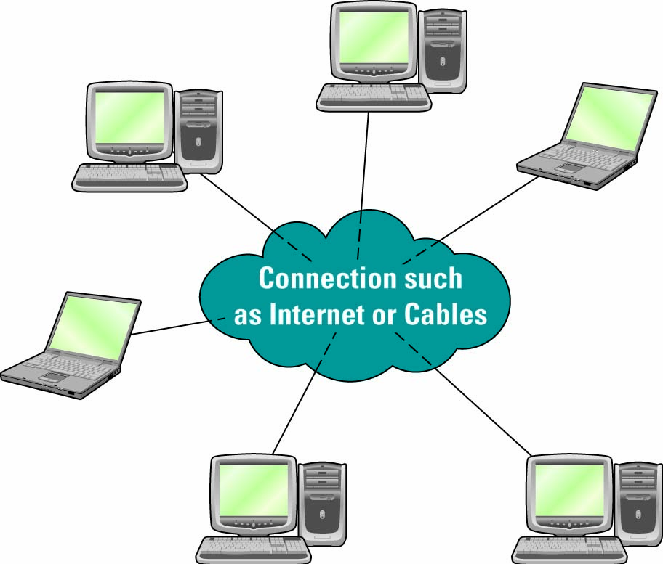
Peer-to-peer Networks
Peer-to-peer (P2P) network - Any network without a central file server and in which all computers in the network have access to the public files located on all other workstations
Notes:
BitTorrent is an excellent example of peer-to-peer
Discuss the Apply Your Knowledge project on BitTorrent (AYK project 7 – Contemplating Sharing)

Slide 24
Client/Server Networks
Client - A computer that is designed to request information from a server
Server - A computer that is dedicated to providing information in response to external requests
Client/server network - Model for applications in which the bulk of the back-end processing takes place on a server, while the front-end processing is handled by the clients
Notes:
Is your PC a client or a server?
Chances are most student computers are clients on the universities network
Can your PC be a client or a server?
Both, any PC can be used as a server – you simply install the server operating system

Slide 25
Network Topology
Network topology is the physical layout of a network. The three different network topology are:
Ring
Bus
Star

Slide 26
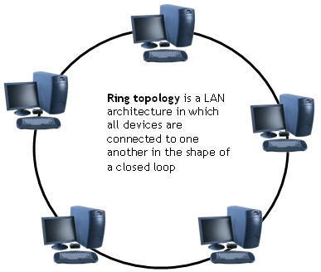
Ring
Uses an empty data packet called a token and a special protocol called “token ring”. Packets travel around the ring in a clockwise direction. Clients require an empty token to transmit data.
Advantages
- no collisions because all data travels in same direction.
Disadvantages
- fails if an individual node in the network fails

Slide 27
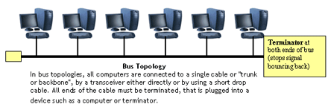
BUS TOPOLOGY
A bus is a form of Ethernet. Nodes linked by a cable known as the bus. Bus transmits in both directions and uses CSMA/CD protocol
Advantages - Easy to set up and maintain failure of one node does not affect network | Disadvantages Higher rate of data collision than with a star network fails if there is any damage to the bus
Notes:
Easy to add extra computers . If computer goes down it doesn’t affect rest of network

Slide 28
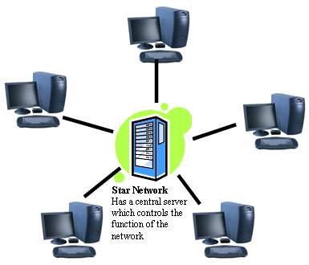
Star
All data is sent from one client to another through the server.
Advantages
- If one client fails no other clients are affected.
Disadvantages
- If central file server fails the network fails.
Notes:
If central host goes doewn affects rest of network

Slide 29
What is I N T E R N E T ?
A network of networks, joining many government, university and private computers together and providing an infrastructure for the use of E-mail, bulletin boards, file archives, hypertext documents, databases and other computational resources.

Slide 30
History of internet
Vinton Cerf is the father of internet. It all started in 1969 when a message was sent over the ARPANET from computer science Professor Leonard, K. at University of California. Advanced Research Projects Agency (ARPA) of the US Department of Defence (DoD) (around 1969) were contracted to bring ARPANET online and it was made publically available.

Slide 31
Internet Services
Electronic Mail (e-mail)
World Wide Web
Telnet
File Transfer Protocol (FTP)

Slide 32
Electronic Mail (e-Mail)
Distributes e-mail messages and attached files to one or more electronic mailboxes.
Eg:- e-mail addresses
thomas@mes.edu.in
murugan@mesmarampally.org

Slide 33
Electronic Mail (e-Mail)
thomas @ mes . edu . in
murugan @ mesmarampally . org
Name of Person
Organization
Type of Organization
Country

Slide 34
Electronic Mail (e-Mail)
Different e-mail service providers
G-Mail
Yahoo Mail
Hot Mail

Slide 35
World Wide Web (W W W)
Most important service provided by Internet.
World wide web is the most popular and promising method of organizing and accessing information on the internet
An internet-based hypermedia initiative for global information sharing.
Developed in 1989 by Tim Berners-Lee of the European Particle Physics Lab in Switzerland.

Slide 36
File transfer protocol (FTP)
It allow user to move file from one computer to another on the internet.
Moving file from a remote computer to one’s own computer is known as downloading where as moving file from one’s own computer to a remote computer is known as uploading.
Anonymous FTP site in a computer allows a user to log in with the user name of anonymous and password that is user’s e-mail address.

Slide 37
Telnet
Telnet service is an internet service that allow a user to log into another computer somewhere in the internet.
Some common uses of telnet service are
Using the computing power of the remote computer
Using the software on the remote computer
Accessing remote computers database or archive
Logging into one’s own computer from another computer.

